Slide 1

Goodreads Book Data Analysis - Using Spotfire
Made by :-
PE 49 Afroz Chakure
PE 46 Aditya Sankolli
PE 07 Adesh Pawar
PE 01 Akash Rajput

Slide 2
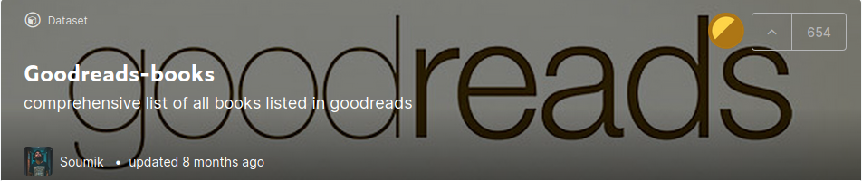
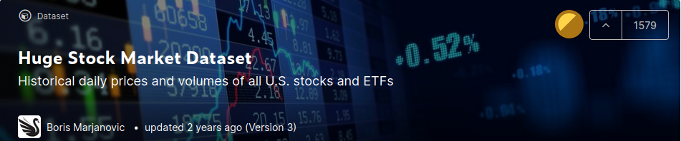
Dataset Used
Analyzing Stock Performance (Applying K-means)
Goodreads Dataset (Applying Visualizations)

Slide 3

Tool Used
TIBCO Spotfire
TIBCO Spotfire is an analytics platform. It was a business intelligence company based in Somerville, Massachusetts that was bought by TIBCO in 2007.
The new A(X) version was launched in November 2018 and includes natural language search and AI-powered insights, a new user interface, automated data flows, and real-time data streams.

Slide 4
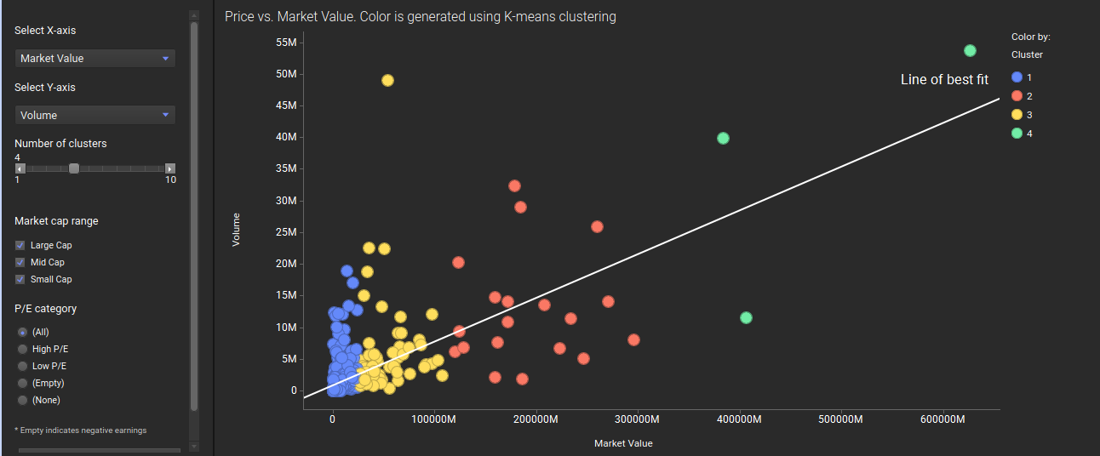
Applying K-means to Stock Market Dataset

Slide 5
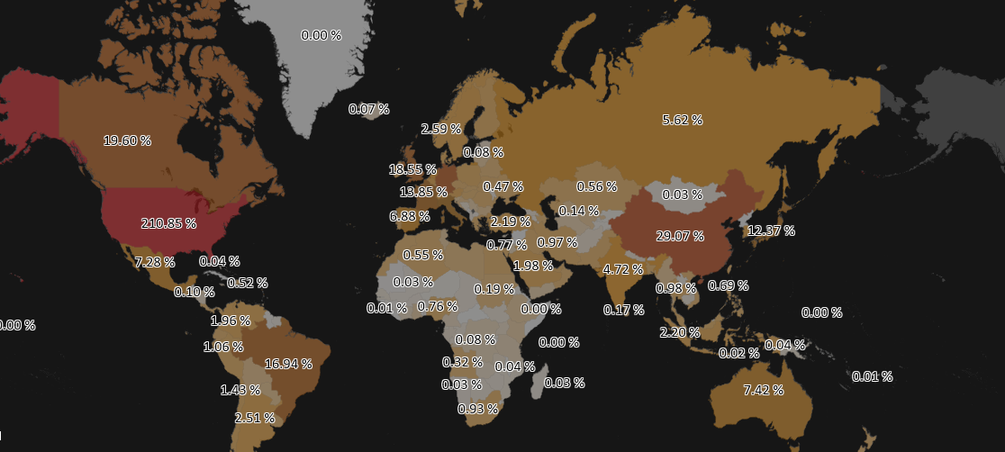
Revenue by Country

Slide 6
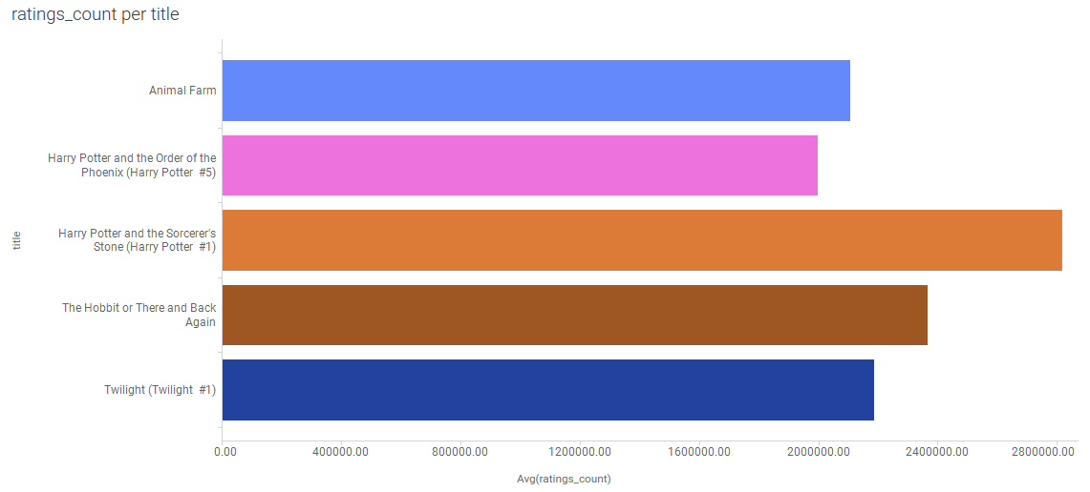
Rating Count vs Title

Slide 7
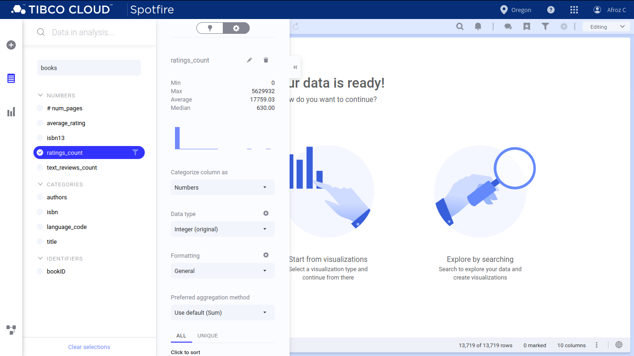
Min, Max, Average, Median

Slide 8
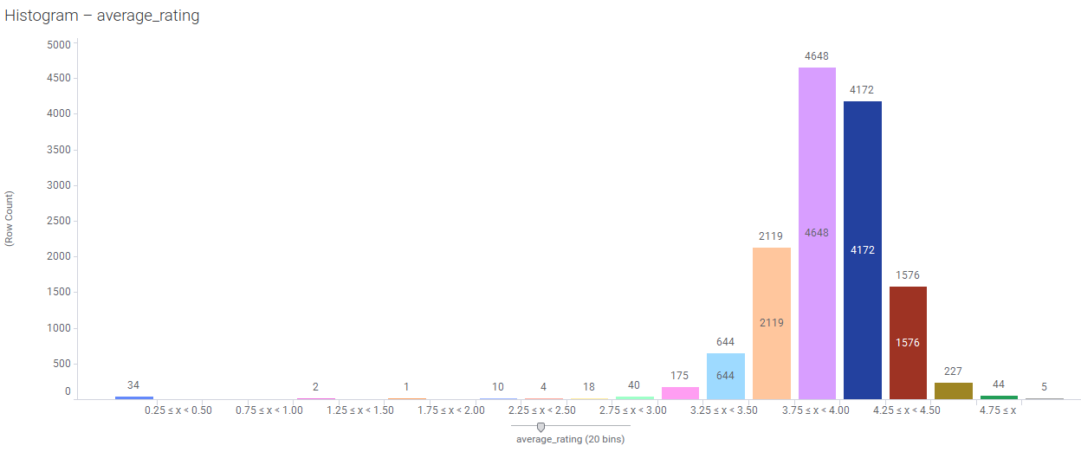
Histogram for Average Rating

Slide 9
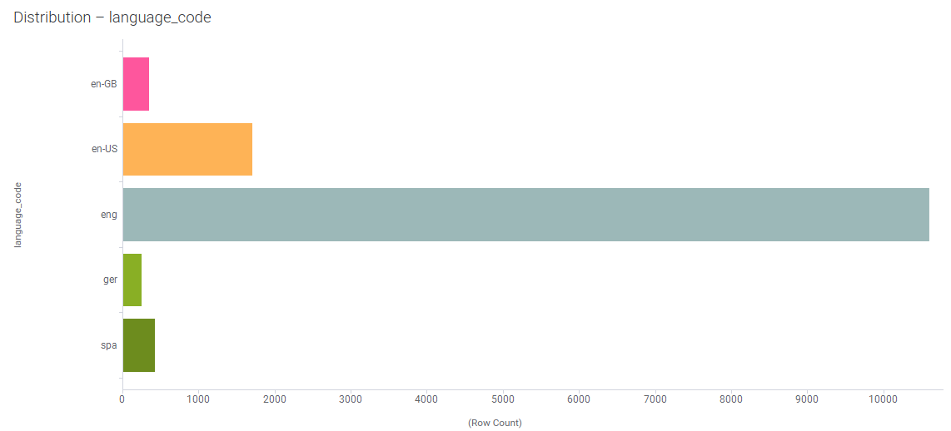
Distribution Language Code

Slide 10
Thank You !!

